Slide 1
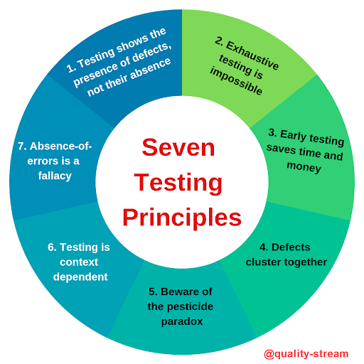
Software Testing 7 Key Principles
Presented By……….
Dharti Jethwa

Slide 2

1.Testing Shows Presence of Defects.
Testing can show that defects are present, but cannot prove that there are no defects.
Testing reduces the probability of undiscovered defects remaining in the software but, even if no defects are found, it is not a proof of correctness.
We test to find Faults .
As we find more defects, the probability of undiscovered defects remaining in a system reduces.
However Testing cannot prove that there are no defects present

Slide 3
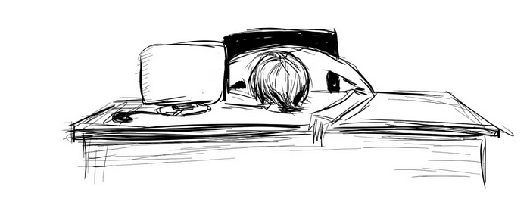
2. Exhaustive Testing is Impossible!
It is the process of testing the functionality of the software in all possible inputs (valid or invalid) and pre-conditions is known as exhaustive testing.
Exhaustive testing is impossible means the software can never test at every test case.
It can test only some test cases and assume that the software is correct and it will produce the correct output in every test case.
If the software will test every test case then it will take more cost, effort, etc., which is impractical.

Slide 4
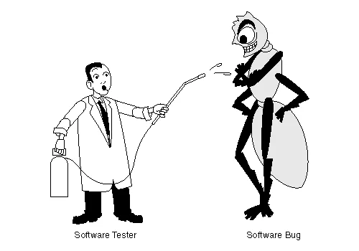
3.Early Testing
To find the defect in the software, early test activity shall be started.
The defect detected in the early phases of SDLC will be very less expensive.
For better performance of software, software testing will start at the initial phase i.e. testing will perform at the requirement analysis phase.

Slide 5
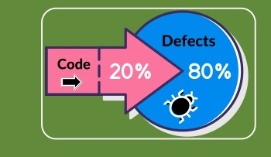
4.Defect Clustering
In a project, a small number of modules can contain most of the defects.
The Pareto Principle for software testing states that 80% of software defects come from 20% of modules.
An important consideration in test prioritization!

Slide 6

5. Pesticide Paradox
Repeating the same test cases, again and again, will not find new bugs.
So it is necessary to review the test cases and add or update test cases to find new bugs.
If the same tests are repeated over and over again, eventually the same set of test cases will no longer find any new defects.
To overcome this “pesticide paradox”, the test cases need to be regularly reviewed and revised, and new and different tests need to be written to exercise different parts of the software or system to potentially find more defects.

Slide 7
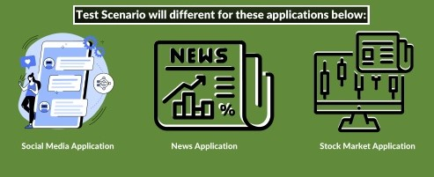
6. Testing is Context Dependent.
Testing is done differently in different contexts .
Different kinds of sites are tested differently.
For example
Safety – critical software is tested differently from an e-commerce site.

Slide 8

7. Absence of Errors Fallacy
If a built software is 99% bug-free but does not follow the user requirement then it is unusable.
It is not only necessary that software is 99% bug-free but it is also mandatory to fulfill all the customer requirements.

Slide 9
Thank You…

